Slide 1
The Common Gateway Interface (CGI)
Introduction
Internal working of CGI
Configuring the server

Slide 2
Introduction
Common Gateway Interface
Create webpages based on information from buttons, checkboxes, text input and so on
Usually, when you browse a webpage, you send a request to a HTTP server for a file, say index.html, and it will send it back to you
How about, the file is an executable script?
  HTTP servers execute the scripts and send outputs back to you
Notes:
4

Slide 3

Features of CGI
CGI can be:
  platform independent scripts (Perl scripts) or
  platform dependent (compiled C programs)
CGI script is loaded every time it is invoked and unloaded when it has finished
CGI programs run in server side
  The outputs will be sent to the user browsers for display
Notes:
14

Slide 4
Normal HTML vs. CGI
With normal HTML, the browser receives HTML, and decodes it for presentation
The browser also sends regular URL (pointer requests)
With CGI, your browser sends
  PUT or GET
  something else, not regular URL,
  call for a program

Slide 5
CGI Concept I
Input to the Common Gateway Interface
  describes the input from Web client to server,
Output from the Common Gateway Interface
  describes the output that a Web server sends to a client
Forms and CGI
  HTML forms and to some simple form-based CGI applications
Server Side Includes
  useful, quick services that the server can handle for the user, such as inserting the current date into the document

Slide 6
CGI Concept II
Hypermedia Documents
  a variety of ways to incorporate graphics and animation into CGI output
  Among the languages and extensions are PostScript, gnuplot, the gd extension to Perl, and the pgperl plotting library
Multiple Form Interaction
  several approaches to passing information between multiple CGI programs
  usage hidden fields, Netscape's persistent cookies, and CGI side includes to maintain state

Slide 7
What Is CGI?
CGI is the part of the Web server that can communicate with other programs running on the server
With CGI, the Web server can call up a program, while passing user-specific data to the program
  such as what host the user is connecting from, or input the user has supplied using HTML form syntax
  The program then processes that data and the server passes the program's response back to the Web browser

Slide 8
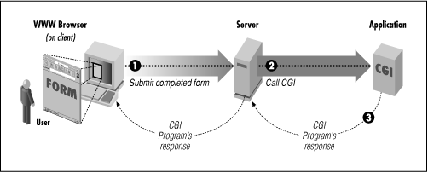
Simple Diagram of CGI

Slide 9
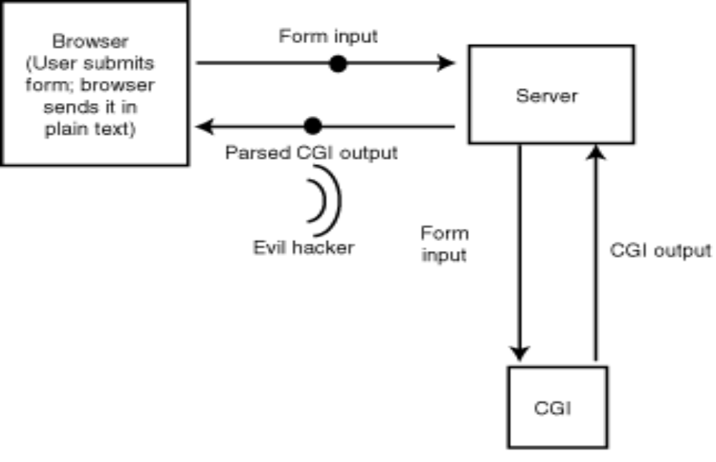
CGI

Slide 10
How CGI Works
Recall discussion of clients vs. servers
The Common Gateway Interface (CGI)
  is an agreement between HTTP server implementors about how to integrate such gateway scripts and programs
CGI programs are scripts written for the http server (httpd)
The specs for CGI (1.1 and 1.2) are at http://www.w3.org/hypertext/WWW/CGI/

Slide 11
How CGI scripts work (2)
The browser:
  decodes the first part of the URL and contacts the server
  supplies the remainder of the URL to the server
The server:
  translates the URL into a path and file name
  realizes that the URL points to a program instead of a static file

Slide 12
How CGI scripts work (3)
The server prepares the environment and launches the script
The script executes and reads the environment variables and STDIN
The script sends the proper MIME headers to STDOUT for the forthcoming content
The script sends the rest of its output to STDOUT and terminates

Slide 13
How CGI scripts work (4)
Non-parsed Header (nph) scripts can bypass the server, sending stuff directly back to the browser
The server notices that the script has finished and closes the connection to your browser
  NOTE: stateless, connectionless
The browser displays the output from the script

Slide 14
Where CGI scripts live
CGI programs can reside anywhere, provided the location is recognized by the http server
  “Anywhere” means on same machine or other, same directories or other
  Best if set apart from document structure
Usually should be better protected, for fame, security, property reasons

Slide 15
CGI Applications
CGI turns the Web from a simple collection of static hypermedia documents into a whole new interactive medium, in which users can ask questions and run applications:
  Forms

Slide 16
Forms
One of the most prominent uses of CGI is in processing forms
Forms are a subset of HTML that allow the user to supply information
The forms interface makes Web browsing an interactive process for the user and the provider

Slide 17
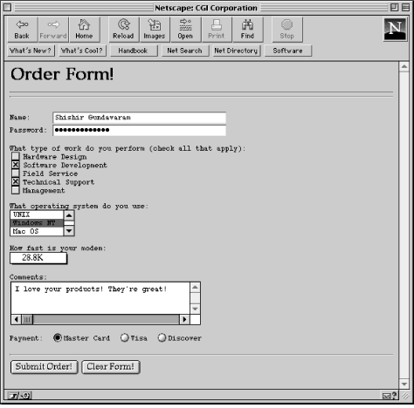
Simple form illustrating different widgets I

Slide 18
Simple form illustrating different widgets II
As can be seen from the previous slide, a number of graphical widgets are available for form creation, such as radio buttons, text fields, checkboxes, and selection lists
When the form is completed by the user, the Submit Order! button is used to send the information to the server, which executes the program associated with the particular form to "decode" the data

Slide 19
Purposes of the Forms
Generally, forms are used for two main purposes:
  At their simplest, forms can be used to collect information from the user
  But they can also be used in a more complex manner to provide back-and-forth interaction
E.g., the user can be presented with a form listing the various documents available on the server
  A CGI program can process this information and return document(s) that match the user's selection criteria

Slide 20
Gateways I
Web gateways are programs or scripts used to access information that is not directly readable by the client
E.g., say you have an Oracle database that contains baseball statistics for all the players on your company team and you would like to provide this information on the Web
How would you do it?
You certainly cannot point your client to the database file (i.e., open the URL associated with the file) and expect to see any meaningful data

Slide 21
Gateways II
CGI provides a solution to the problem in the form of a gateway or a DBI extension to Perl to form SQL queries to read the information contained within the database
Once you have the information, you can format and send it to the client
In this case, the CGI program serves as a gateway to the Oracle database, as shown in the next slide

Slide 22
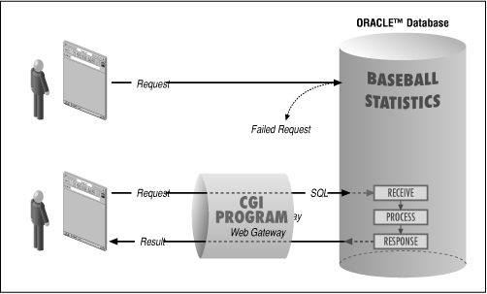
A gateway to a database

Slide 23
Gateways III
Similarly, you can write gateway programs to any other Internet information service, including:
  Archie
  WAIS
  NNTP (Usenet News)
You can amplify the power of gateways by using the forms interface to request a query or search string from the user to retrieve and display dynamic (“virtual”) information

Slide 24
Virtual Documents I
Virtual, or dynamic, document creation is at the heart of CGI
  Virtual documents are created on the fly in response to a user's information request
It is possible o create virtual HTML, plain text, image, and even audio documents
A simple example of a virtual document could be something as trivial as this:
    Welcome to Shishir's WWW Server!
    You are visiting from diamond.com. The load average on this machine is 1.25
    Happy navigating!

Slide 25
Virtual Documents II
In this example, there are two pieces of dynamic information:
  the alphanumeric address (IP name) of the remote user and
  the load average on the serving machine
On the other hand, very complex virtual documents can be created by writing programs that utilize a combination of graphics libraries, gateways, and forms

Slide 26
Internal Workings of CGI I
So how does the whole interface work?
Most servers expect CGI programs and scripts to reside in a special directory, usually called cgi-bin, and/or to have a certain file extension
When a user opens a URL associated with a CGI program, the client sends a request to the server asking for the file

Slide 27
Internal Workings of CGI II
For the most part, the request for a CGI program looks the same as it does for all Web documents
The difference is that when a server recognizes that the address being requested is a CGI program, the server does not return the file contents verbatim
  Instead, the server tries to execute the program
Here is what a sample client request might look like:
    GET /cgi-bin/welcome.pl HTTP/1.0
    Accept: www/source
    Accept: text/html
    Accept: image/gif
    User-Agent: Lynx/2.4 libwww/2.14
    From: shishir@bu.edu

Slide 28
Internal Workings of CGI III
This GET request identifies the file to retrieve as
/cgi-bin/welcome.pl
Since the server is configured to recognize all files in the cgi-bin directory tree as CGI programs, it understands that it should execute the program instead of relaying it directly to the browser
The string HTTP/1.0 identifies the communication protocol to use
The client request also:
  passes the data formats it can accept (www/source, text/html, and image/gif),
  identifies itself as a Lynx client, and
  sends user information
All this information is made available to the CGI program, along with additional information from the server

Slide 29
Internal Workings of CGI IV
The way that CGI programs get their input depends on the server and on the native operating system
On a Linux system, CGI programs get their input from standard input (STDIN) and from Linux environment variables
These variables store such information as:
  the input search string (in the case of a form)
  the format of the input
  the length of the input (in bytes)
  the remote host and user passing the input
  other client information
They also store:
  the server name
  the communication protocol
  the name of the software running the server

Slide 30
Internal Workings of CGI V
Once the CGI program starts running, it can:
  either create and output a new document
  or provide the URL to an existing one
On UNIX/Linux, programs send their output to standard output (STDOUT) as a data stream
The data stream consists of two parts
  The first part is either a full or partial HTTP header that (at minimum) describes what format the returned data is in,
    e.g.:HTML, plain text, GIF, etc.
    A blank line signifies the end of the header section
  The second part is the body, which contains the data conforming to the format type reflected in the header
    The body is not modified or interpreted by the server in any way

Slide 31
Internal Workings of CGI VI
A CGI program can choose:
  to send the newly created data directly to the client or
  to send it indirectly through the server
If the output consists of a complete HTTP header, the data is sent directly to the client without server modification
Or, as is usually the case, the output is sent to the server as a data stream
The server is then responsible for adding the complete header information and using the HTTP protocol to transfer the data to the client

Slide 32
Internal Workings of CGI VII
Here is the sample output of a program generating an HTML virtual document, with the complete HTTP header:
    HTTP/1.0 200 OK
    Date: Thursday, 22-February-96 08:28:00 GMT
    Server: NCSA/1.4.2
    MIME-version: 1.0
    Content-type: text/html
    Content-length: 2000
    <HTML>
    <HEAD><TITLE>Welcome to Shishir's WWW Server!</TITLE>
    </HEAD>
    <BODY>
    <H1>Welcome!</H1>
    ...
    </BODY>
    </HTML>

Slide 33
Internal Workings of CGI VIII
The header contains:
  the communication protocol
  the date and time of the response
  the server name and version
  the revision of the MIME protocol
Most importantly, it also consists of the MIME content type and the number of characters (equivalent to the number of bytes) of the enclosed data, as well as the data itself
Now, the output with the partial HTTP header:

Slide 34
Internal Workings of CGI IX
    Content-type: text/html
    <HTML>
    <HEAD><TITLE>Welcome to Shishir's WWW Server!</TITLE></HEAD>
    <BODY>
    <H1>Welcome!</H1>
    ...
    </BODY>
    </HTML>

Slide 35
Internal Workings of CGI X
What is MIME and what does it stand for?
MIME (Multipurpose Internet Mail Extensions) is a specification that was originally developed for sending multiple types of data through electronic mail
MIME types are used to identify types of data sent as content over the Web

Slide 36
Internal Workings of CGI XI
In the previous instance, the only header line that is output is the Content-type header, which describes the MIME format of the output
Since the output is in HTML format, text/html is the content type that is declared
Most CGI programmers prefer to supply only a partial header
It is much simpler to output the format and the data than to formulate the complete header information, which can be left to the server
However, there are times when you need to send the information directly to the client (by outputting a complete HTTP header)

Slide 37
Configuring the Server
Before you can run CGI programs on your server, certain parameters in the server configuration files must be modified
If you are using either the NCSA or CERN HTTP server, you need to first set the ServerRoot directive in the httpd.conf file to point to the directory where the server software is located:
    ServerRoot /usr/local/etc/httpd

Slide 38
Running CGI Scripts
On the NCSA server, the ScriptAlias directive in the server resource map file (srm.conf) indicates the directory where the CGI scripts are placed
    ScriptAlias /cgi-bin/ /usr/local/etc/httpd/cgi-bin/
For example, if a user accesses the URL:
    http://your_host.com/cgi-bin/welcome
the local program:
    /usr/local/etc/httpd/cgi-bin/welcome
will be executed by the server

Slide 39
Multiple directories hold CGI scripts:
    ScriptAlias /cgi-bin/ /usr/local/etc/httpd/cgi-bin/
    ScriptAlias /my-cgi-bin/ /usr/local/etc/httpd/my-cgi-bin/
You might wonder why all CGI programs must be placed in distinct directories
  The most important reason for this is system security
  By having all the programs in one place, a server administrator can control and monitor all the programs being run on the system

Slide 40
Allowing programs to be run outside of the designated directories
There are directives that allow programs to be run outside of these directories, based on the file extension
The following directives, when placed in the srm.conf configuration file, allow the server to execute files containing .pl, .sh, or .cgi extensions
    AddType application/x-httpd-cgi .pl .sh .cgi
However, this could be very dangerous!
By globally enabling all files ending in certain extensions, there is a risk that novice programmers might write programs that violate system security, e.g.:
  Printing the contents of important system files to standard output

Slide 41
httpd.conf File
On the CERN server, setting up the CGI directory is done in the httpd.conf file, using the following syntax:
    Exec /cgi-bin/* /usr/local/etc/httpd/cgi-bin

Slide 42
Programming in CGI
What programming language can be used?
The answer to that question is very simple:
  You can use whatever language you want, although certain languages are more suited for CGI programming than others
Before choosing a language, you must consider the following features:
  Ease of text manipulation
  Ability to interface with other software libraries and utilities (such as databases)
  Ability to access environment variables (in UNIX/Linux)

Slide 43
Programming Languages in CGI
Perl and C, C++ are the most common
Visual Basic and Java rapidly catching up
Many others used too
Tension (choice) between compiled vs. interpreted
Dimensions:
  Portability,
  Ease of learning, debugging
  Speed, efficiency

Slide 44
AppleScript (Macintosh Only)
AppleScript is an integral part of the Macintosh operating system (OS)
Though AppleScript lacks inherent pattern-matching operators, certain extensions have been written to make it easy to handle various types of data
AppleScript also has the power to interface with other Macintosh applications through AppleEvents
E.g., a Mac CGI programmer can:
  write a program that presents a form to the user,
  decode the contents of the form, and
  query and search a Microsoft FoxPro database directly through AppleScript

Slide 45
C/C++ (UNIX/Linux, Windows, Macintosh)
C and C++ are very popular with programmers, and some use them to do CGI programming
These languages are not recommended for the novice programmer
  C and C++ impose strict rules for variable and memory declarations, and type checking
  In addition, these languages lack database extensions and inherent pattern-matching abilities, although modules and functions can be written to achieve these functions
However, C and C++ have a major advantage in that you can compile your CGI application to create a binary executable, which takes up fewer system resources than using interpreters (like Perl or Tcl) to run CGI scripts

Slide 46
C Shell (UNIX/Linux Only)
C Shell lacks pattern-matching operators, and so other UNIX/Linux utilities, such as sed or awk, must be used whenever you want to manipulate string information
However, there is a software tool, called uncgi and written in C, that decodes form data and stores the information into shell environment variables, which can be accessed rather easily
Obviously, communicating with a database directly is impossible, unless it is done through a foreign application
Finally, the C Shell has some serious bugs and limitations that make using it a dangerous proposition for the beginner

Slide 47
Perl (UNIX/Linux, Windows, Macintosh) I
Perl is by far the most widely used language for CGI programming
It contains many powerful features, and is very easy for the novice programmer to learn
The advantages of Perl include:
  It is highly portable and readily available
  It contains extremely powerful string manipulation operators, as well as functions to deal with binary data
  It contains very simple and concise constructs
  It makes calling shell commands very easy
  It provides some useful equivalents of certain UNIX/Linux system functions

Slide 48
Perl II
There are numerous extensions built on top of Perl for specialized functions, e.g.:
  There is oraperl (or the DBI Extensions), which contains functions for interfacing with the Oracle database
Because of these overwhelming advantages, Perl is the language used for most of the examples

Slide 49
Example of Perl I
    #!/usr/local/bin/perl
    print "Content-type: text/plain","\n\n";
    print "Welcome to Shishir's WWW Server!", "\n";
    $remote_host = $ENV{'REMOTE_HOST'};
    print "You are visiting from ", $remote_host, ". ";
    $uptime = `/usr/ucb/uptime` ;
    ($load_average) = ($uptime =~ /average: ([^,]*)/);
    print "The load average on this machine is: ", $load_average, ".", "\n";
    print "Happy navigating!", "\n";
    exit (0);

Slide 50
Example of Perl II
The first line of the program is very important
  It tells the server to run the Perl interpreter located in /usr/local/bin to execute the program
Simple print statements are used to display information to the standard output
This CGI program outputs a partial HTTP header (the one Content-type header)
  Since this script generates plain text and not HTML, the content type is text/plain
Two newlines (\n) are output after the header
  This is because HTTP requires a blank line between the header and body
Depending on the platform, you may need to output two carriage-return and newline combinations (\r\n\r\n)

Slide 51
Example of Perl III
The first print statement after the header is a greeting
The second print statement after the header displays the remote host of the user accessing the server
  This information is retrieved from the environmental variable REMOTE_HOST
The next bit of code is a combination of search operators, and is called a regular expression (or commonly known as regexp)

Slide 52
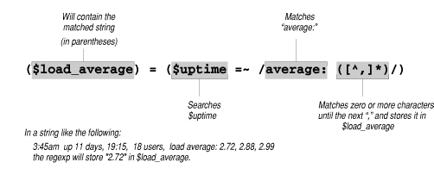
Example of Perl IV
In this case, the expression is used to search the output from the UNIX/Linux command uptime for a numeric value that is located between the string "average:" and the next comma
Finally, the last statement displays a good luck message

Slide 53
Tcl (UNIX/Linux Only)
Tcl is gaining popularity as a CGI programming language
Tcl consists of a shell, tclsh, which can be used to execute your scripts
Like Perl, tclsh also contains simple constructs, but is a bit more difficult to learn and use for the novice programmer
Like Perl, Tcl contains extensions to:
  databases and
  graphic libraries
It also supports regular expressions, but is quite inefficient in handling these expressions at compile time, especially when compared to Perl

Slide 54
Visual Basic (Windows Only)
Visual Basic is to Windows what AppleScript is to the Macintosh OS as far as CGI programming is concerned
With Visual Basic, you can communicate with other Windows applications such as:
  databases and
  spreadsheets
This makes Visual Basic a very powerful tool for developing CGI applications on a PC, and it is very easy to learn

Slide 55
CGI vs. API and server specific technologies
API is emerging as one alternative to CGI
Less portable (not “common”)
“Behind” the server (httpd)
API more efficient, less compliant
Examples:
  Netscape ONE
  Microsoft WindowsDNA
  Oracle and others

